Slide 1



Job Satisfaction
Analysis
Empowering Business Through Analytics.

Slide 2
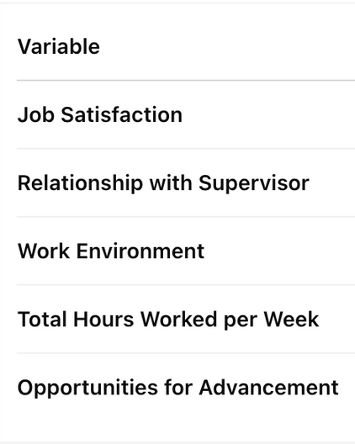
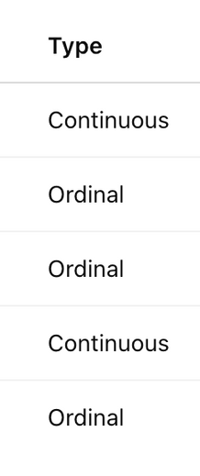
PROBLEM STATEMENT
DATASET OVERVIEW
Identify which of these variables significantly influence Job Satisfaction
Develop a mathematical regression model
Interpret the model using hypothesis testing
Check model diagnostics to assess validity
UNDERSTANDING THE VARIABLES
🔍 Dependent Variable (Target):
Job Satisfaction (scale: 0 to 100)
🔍 Independent Variables (Predictors):
Relationship with Supervisor (scale: 1 to 5)
Overall Quality of Work Environment(scale:0 to 10)
Total Hours Worked per Week (numeric)
Opportunities for Advancement (scale: 1 to 5)
Hypothesis (for each predictor):
H₀: The variable has no impact on Job Satisfaction
H₁: The variable has a significant impact
Total Records: 20 Employees
Total Variables: 5

Slide 3
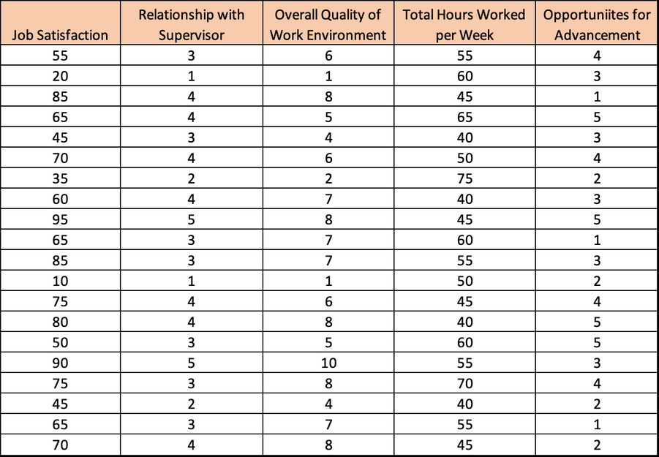
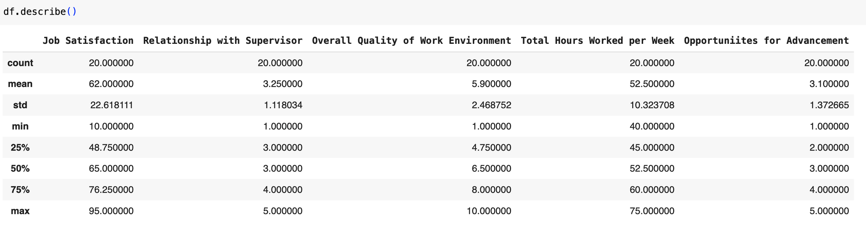

Slide 4

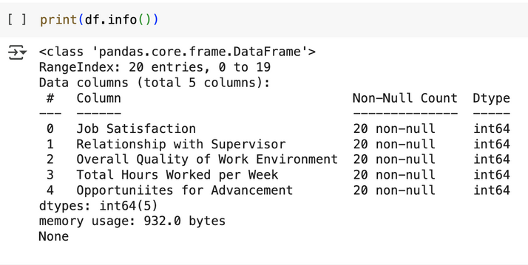

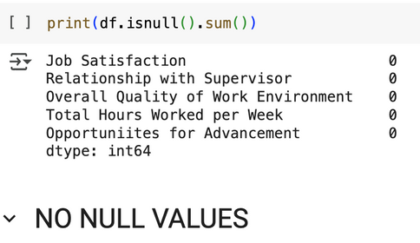
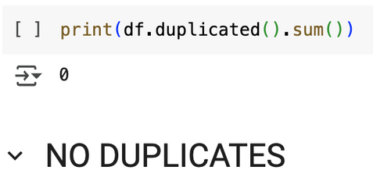

Data Preprocessing
Data pre-processing is the process of transforming raw data into a clean and structured format before analysis. It involves handling missing values, removing duplicates, converting data types, encoding categorical variables, and preparing features for modeling.
Loading and Inspection:
Missing & Duplicate Values:
Feature Selection
To begin with, the dataset was imported using the Pandas library and a preliminary inspection was conducted using functions like ,head() ,describe() and to understand the structure and statistical summary.
IIt was observed that there were no missing or null values across the dataset, and no duplicate entries were present. This ensured the dataset was clean and ready for further analysis. Since all the variables were already numerical, no encoding or scaling was required at this stage.
The target variable, 'Job Satisfaction', was separated for modeling purposes, and the remaining features were treated as independent variables.

Slide 5

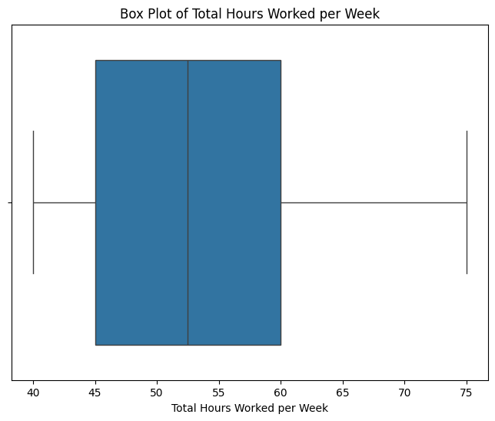
Outlier Detection
To identify potential anomalies, a box plot was generated for the 'Total Hours Worked per Week' column.
THERE ARE NO OUTLIERS IN Total Hours Worked per Week COLUMN (Quantitative) AND AS OTHER COLUMNS ARE ORDINAL CATEGORIES SO CHECKING OUTLIER FOR THEM WILL BE MEANINGLESS

Slide 6
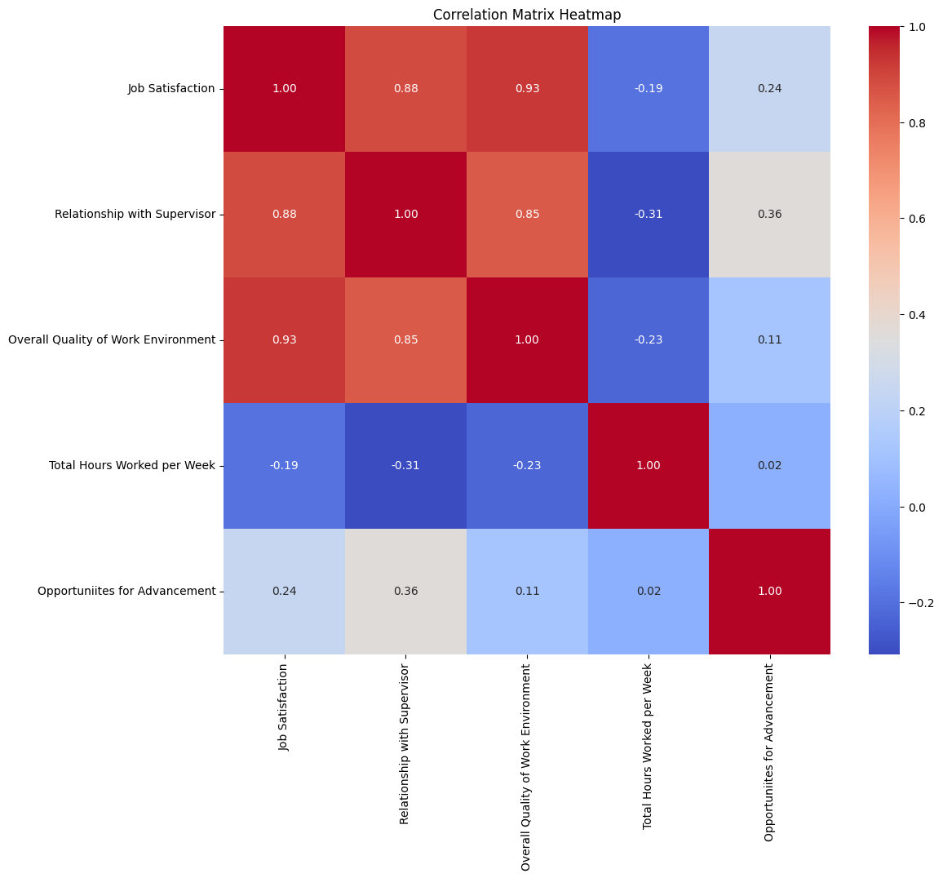

Exploratory Data Analysis (EDA)
The primary method used was a correlation matrix, which was visualized through a heatmap to identify the strength and direction of linear relationships between the variables.
This helped in understanding how each feature relates to 'Job Satisfaction' and to each other.
For instance, features like 'Relationship with Supervisor' and 'Quality of Work Environment' showed a positive correlation with job satisfaction, while 'Total Hours Worked per Week' appeared to have a weak or negative correlation.
In addition to correlation analysis, multiple linear regression was conducted to evaluate the impact of all independent variables on the dependent variable.
The regression summary provided insights into statistical significance through p-values, while the Variance Inflation Factor (VIF) analysis helped detect multicollinearity between predictors.
Lastly, a stepwise regression technique was implemented to iteratively remove features with high p-values, thereby optimizing the model by retaining only the most significant variables for prediction.

Slide 7
Assumptions
ML Model Identification
Linearity
The relationship between the independent variables and the dependent variable is linear.
Homoscedasticity
The variance of residuals is constant across all levels of the independent variables.
Normality of Residuals
Residuals should be normally distributed for valid hypothesis testing.
No Multicollinearity
Independent variables should not be highly correlated with each other.
Multiple Linear Regression (MLR)
❓ Why Chosen?
The target variable, Job Satisfaction, is continuous in nature (ranging from 0 to 100).
MLR is suitable for modeling relationships between a continuous dependent variable and multiple independent variables.
We aim to understand how each predictor variable (supervisor relationship, work environment, hours worked, etc.) influences job satisfaction.
Provides both predictive capability and interpretability through coefficients and statistical significance.
📈 MODEL SUMMARY
Job Satisfaction = β₀ + β₁(SupervisorRel) + β₂(WorkEnv) + β₃(HoursPerWeek) + β₄(Advancement) + ε
Y = β₀ + β₁X₁ + β₂X₂ + ... + βₙXₙ + ε
Where:
Y = Job Satisfaction
X₁ to Xₙ = Predictor variables
β = Coefficients
ε = Error term

Slide 8

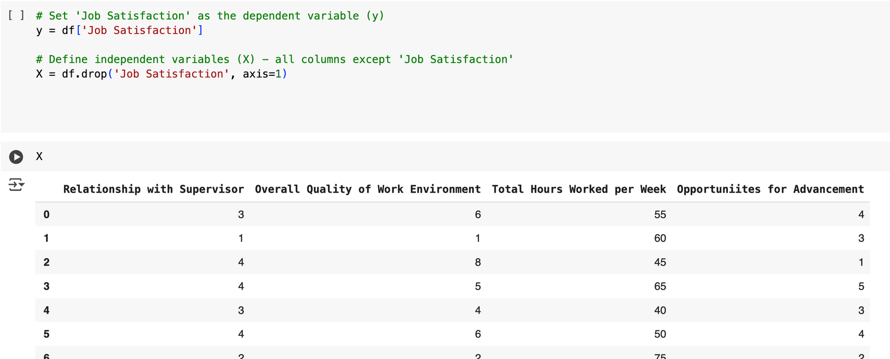
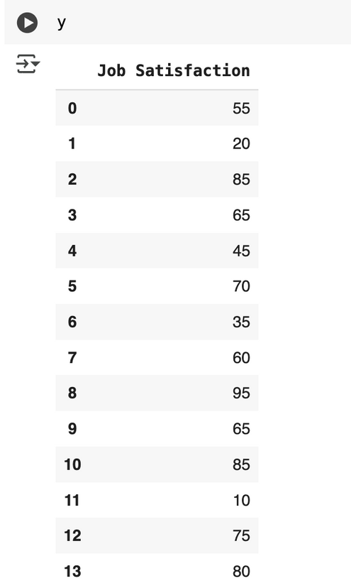
INDEPENDENT VARIABLES (X)
Defining independent and dependent variables
DEPENDENT VARIABLE (y): JOB SATISFACTION

Slide 9
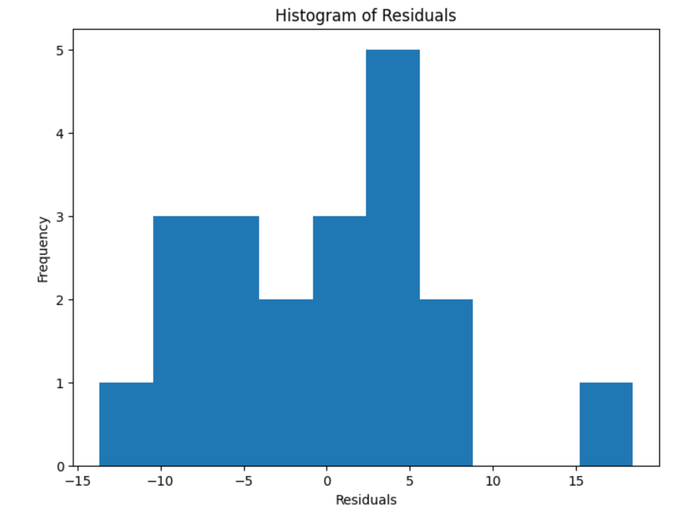
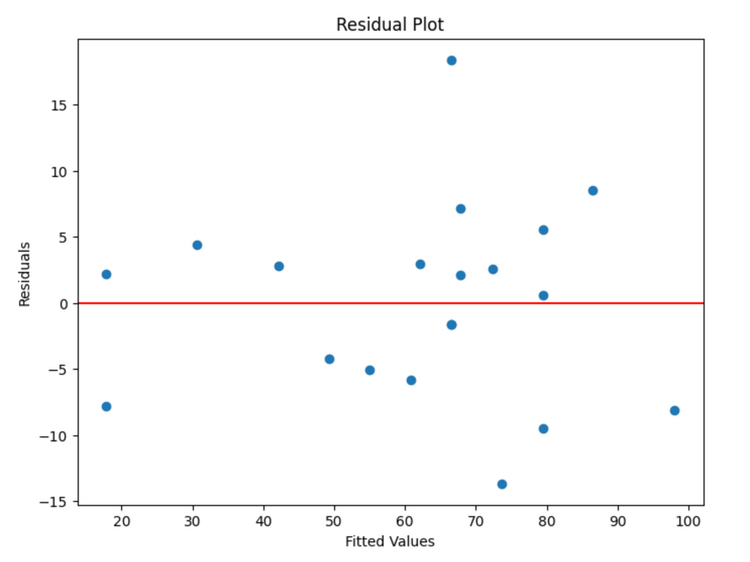
CHECKING FOR LINEARITY & HOMOSCEDASTICITY
1. Residual Plot : The residuals are randomly scattered around zero, which suggests that the assumptions of linearity and homoscedasticity (equal variance) are reasonably met.
2. Histogram of Residuals : The residuals are roughly symmetric but slightly skewed, indicating an approximate normal distribution.

Slide 10
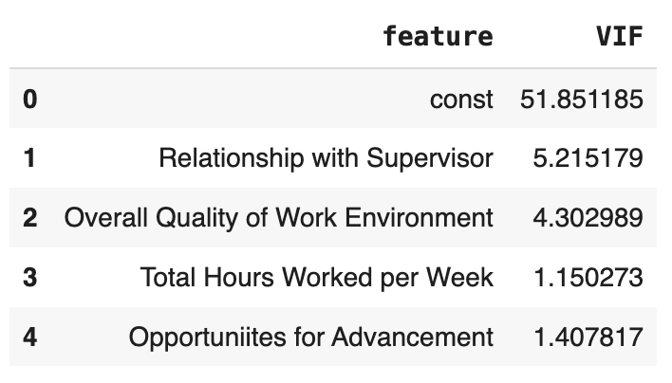
CHECKING FOR MULTICOLLINEARITY
No column needs to be removed right now, because:
The highest VIF(VARIANCE INFLATION FACTOR) is 5.22
All features are meaningful and interpretable for predicting Job Satisfaction as :
VIF < 5 → Acceptable
VIF > 5 → Potential multicollinearity concern
VIF > 10 → Serious concern (consider dropping)

Slide 11
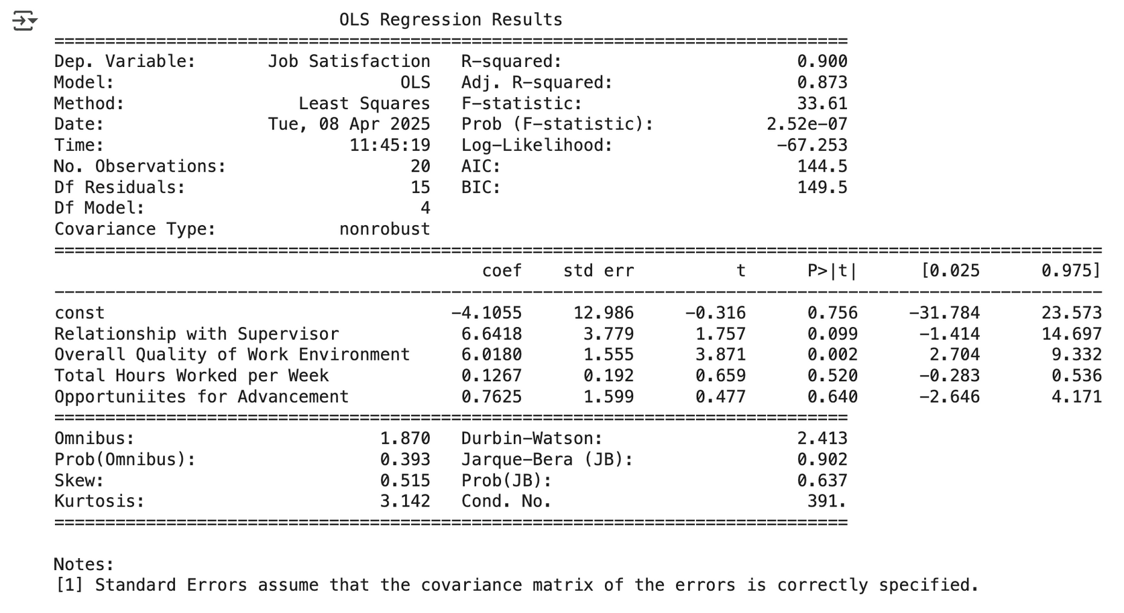
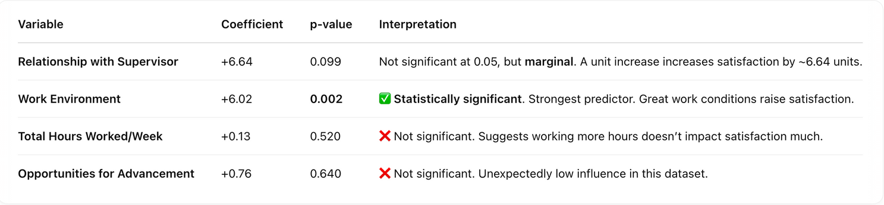
RUNNING MUPTIPLE LINEAR REGRESSION

Slide 12
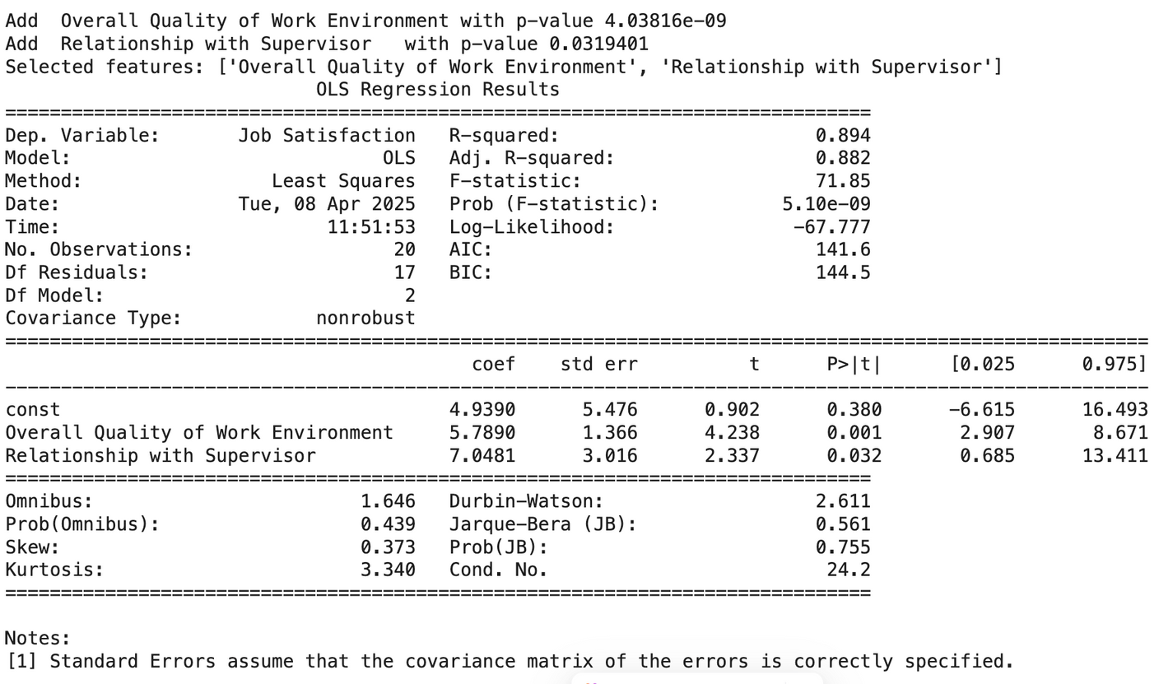
STEP BY STEP REGRESSION
✅ MODEL FIT
R-squared = 0.894 (Model explains 89.4% of the variation in Job Satisfaction which is high)
The model shows that Work Environment and Relationship with Supervisor are both significant predictors of job satisfaction.

Slide 13

📊 INTERPRETATION OF COEFFICIENTS
Variable | Coefficient | p-value | Interpretation
Overall Quality of Work Environment | +5.79 | 0.001 | A unit improvement in the work environment increases job satisfaction by ~5.79 units. Strongest predictor.
Relationship with Supervisor | +7.05 | 0.032 | Also significant. Better supervisor relationship leads to ~7.05 unit increase in job satisfaction.
Intercept (const) | 4.94 | 0.380 | Not statistically significant; represents base satisfaction level when predictors = 0.
REGRESSION EQUATION
Job Satisfaction = 4.39 + 5.79 * (Overall Quality of Work Environment) + 7.05 * (Relationship with Supervisor)
A 1-point improvement in work environment boosts job satisfaction by 5.79 points
A 1-point improvement in supervisor relationship increases it by 7.05 points

Slide 14
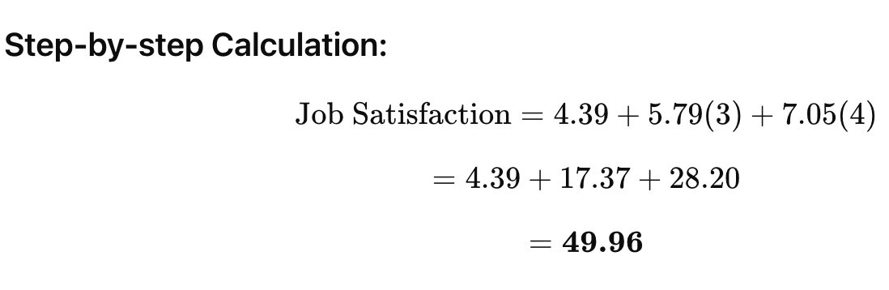
EXAMPLE TO ILLUSTRATE HOW TO USE REGRESSION EQUATION:
Regression Equation:
Job Satisfaction= 4.39 + 5.79 * (Overall Quality of Work Environment) + 7.05 * (Relationship with Supervisor)
Plugging values for a hypothetical employee:
Work Environment score = 3
Supervisor Relationship score = 4
This employee is predicted to have a job satisfaction score of approximately 49.96 based on their perception of the work environment and their relationship with their supervisor.

Slide 15
🧪 HYPOTHESIS TESTING SUMMARY
H₀: The variable has no significant effect on Job Satisfaction
H₁: The variable does affect Job Satisfaction
PREDICTOR | P-VALUE | REJECT H₀?
WORK ENVIRONMENT | 0.001 | ✅ YES
RELATIONSHIP WITH SUPERVISOR | 0.032 | ✅ YES
Conclusion: Both Overall Quality of Work Environment and Relationship with Supervisor have a statistically significant positive impact on Job Satisfaction.

Slide 16





CONCLUSION
key Takeaways
IMPLICATIONS
A Multiple Linear Regression model was developed to predict Job Satisfaction using four predictors.
After analysis, the two most significant predictors identified were:
Overall Quality of Work Environment
Relationship with Supervisor
Improving the work environment and supervisor relationships can significantly boost employee satisfaction.
These findings can guide HR and management decisions to enhance organizational well-being and performance.
📊 Model Performance:
The model explains 89.4% of the variation in Job Satisfaction (R² = 0.894).
It passed all major diagnostic tests, confirming:
No multicollinearity
Normal distribution of residuals
Statistically significant regression model

Slide 17
Thank You

